Slide 1


Running Water
Created By; Dr. Suzanne Till, Sophia Jordan, Joshua Narezo, Fernanda Lutteroth
Team 307: Watergirlz & a Boy
How can Californians maintain a daily health regimen? Drink more water!
40% of school districts reported no access to free drinking water in eating areas.
62 % of high school students drink one soda a day
54.4 % of students do not meet minimum daily water in take requirement
Mild levels of dehydration alters concentration, alertness, and short term memory in children

Slide 2
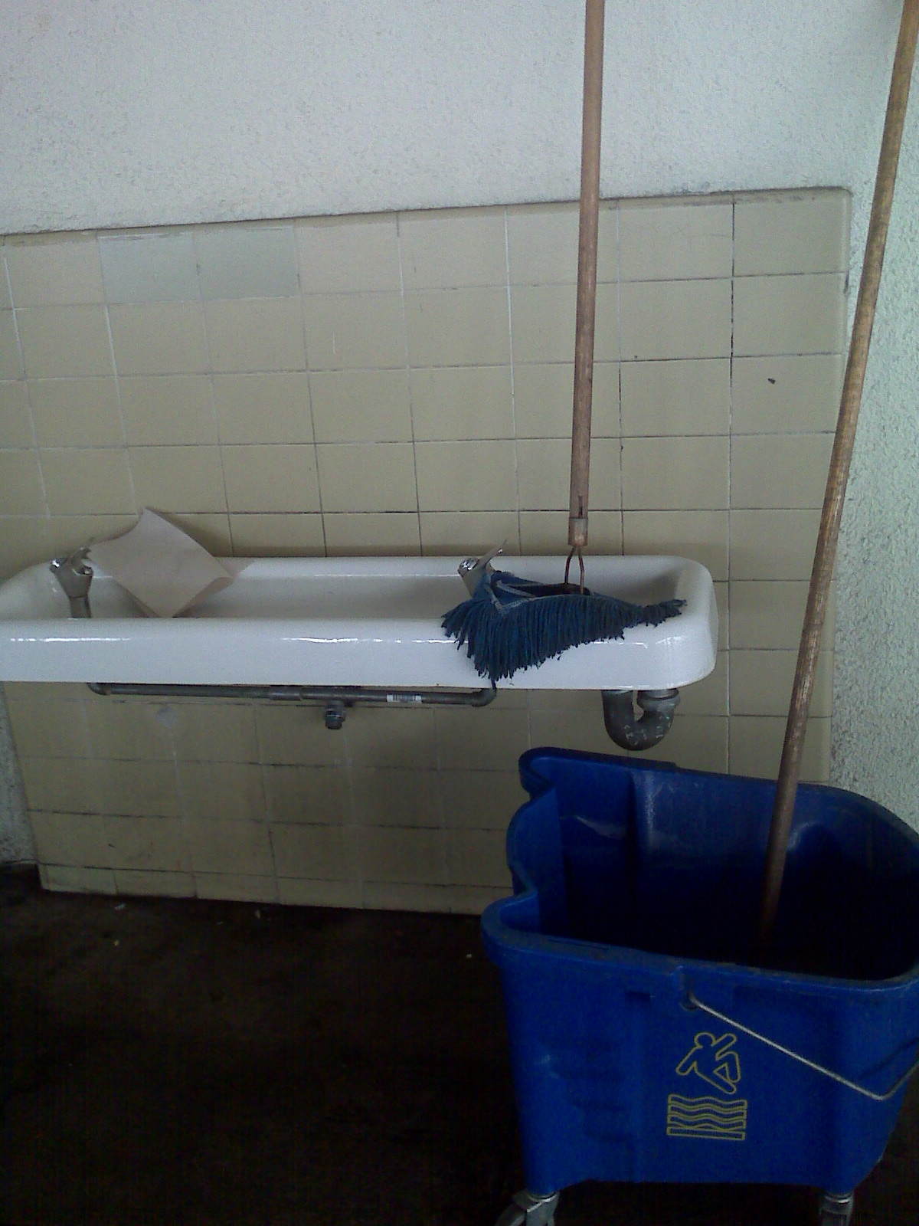
Senate Bill1413: Why do students NOT drink water?
Water is not cold.
Not enough drinking fountains on school or college campus.
Poorly maintained water infrastructure, water faucets.
San Ysidro School District Water Quality? Is water on campus safe to drink?

Slide 3

Proposal
A data collection app with a website for students & families to locate, take a photo, and enter data on water sources for a school, college campus and/or family recreation area (Balboa Park for example).
Water Audit Tool from the Harvard School of Public Health.
http://www.inaturalist.org/ -- sample app and website.
Data integrated into a GIS map, accessible on a website.
Information and maps will be sent to the school district, college campus, water district and State of CA on the status of drinking water facilities for children and college students.

Slide 4
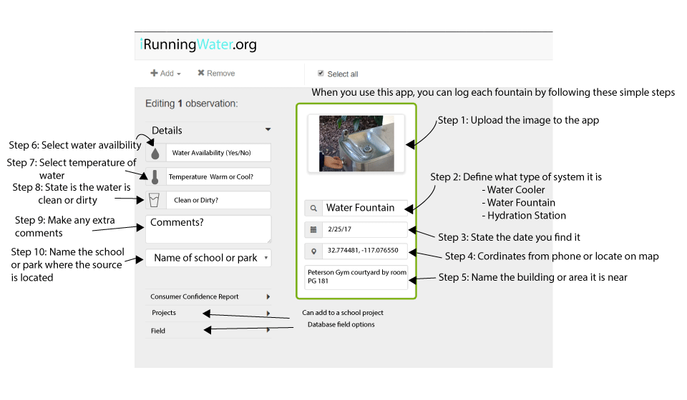
Actual Data Point of
Broken Water Fountain: Peterson Gym, SDSU

Slide 5
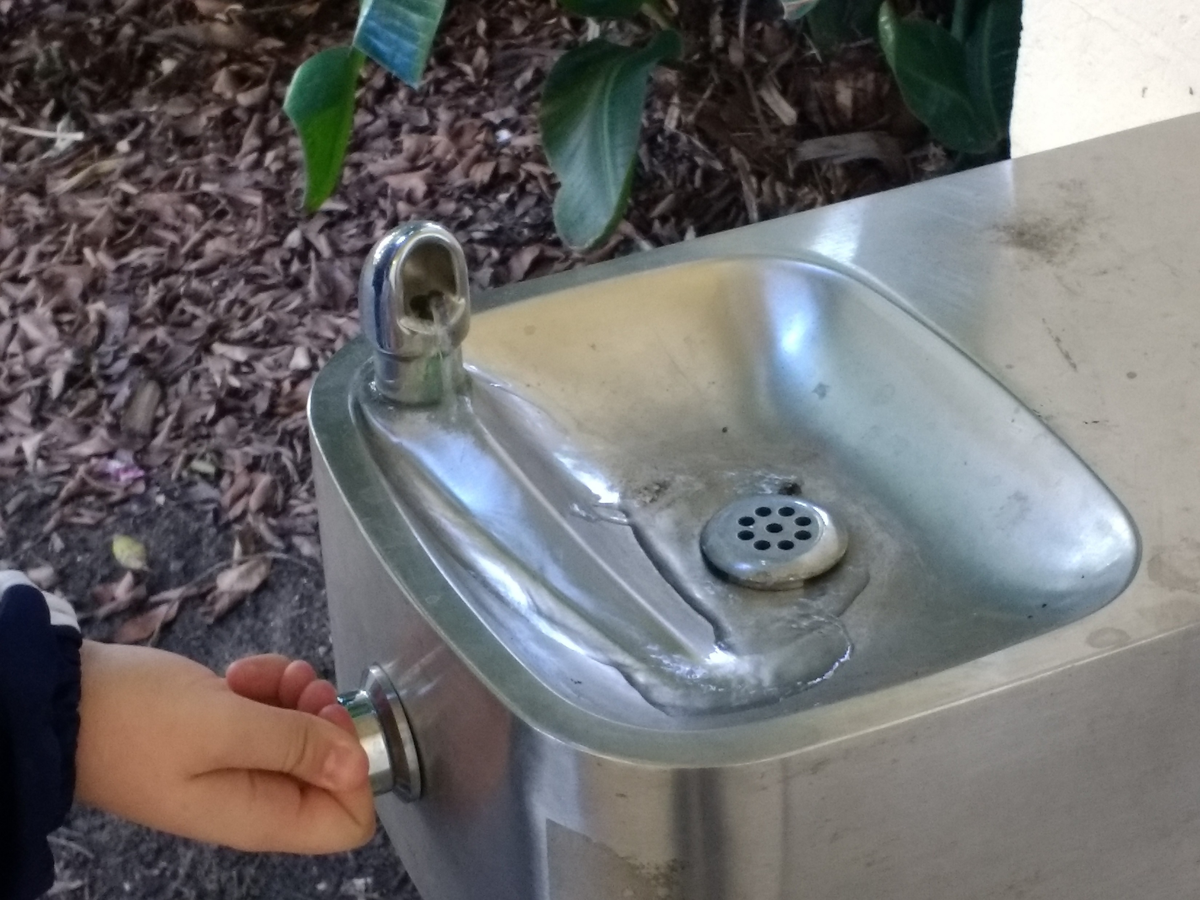
Running Water: Next Steps and Coding
Next Steps – who you know --
Reverse engineering with inaturalist.org, SDNHM, CA Academy of Sciences.
Code for America
Website Host: Blue Gold@SDSU, UC Riverside?
Coding:
Android SDK, XML & Java
Website in HTML, Javascript (D3 Graphing Library)
MySQL backend

